Slide 1
Lesson 13 - Looping Over a Grid
Mr Mack 2019

Slide 2
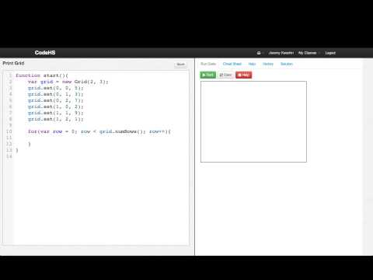
Looping Over a Grid

Slide 3
Which function will correctly print out the second column of a grid (assuming there is a second column)?
function printSecondColumn(grid){
for(var row = 0; row < grid.numRows(); row++){
var elem = grid.get(row, 1);
println(elem);
}
}
function printSecondColumn(grid){
for(var col = 0; col < grid.numCols(); col++){
var elem = grid.get(1, col);
println(elem);
}
}

Slide 4
Which function will correctly print out the first row (top row) of a grid?
function printFirstRow(grid){
for(var row = 0; row < grid.numRows(); row++){
var elem = grid.get(row, 0);
print(elem + " ");
}
}
function printFirstRow(grid){
for(var col = 0; col < grid.numCols(); col++){
var elem = grid.get(0, col);
print(elem + " ");
}
}

Slide 5
Example: Print Grid
This is an example for this lesson. You are encouraged to play around with it, run and change the code, and learn how it works. When you are done, click continue to go to the next problem.

Slide 6
Exercise 5.13.1: Summing Grid
Write a function called
function sumGrid(grid)
that takes a grid as a parameter and fills each location in the grid with the sum of the row index and column index of that location.
For example, this code:
var grid = new Grid(2, 3);
println(sumGrid(grid));
Should output:
0 1 2
1 2 3
Test your function by calling it several times, and printing out the grid.

